Slide 1
python project
Neta Ehrenberg & Shimon Funaro

Slide 2
01
Background, data & research question

Slide 3
Our dataset:
Our research question:
Our dataset had information on patients with epilepsy that underwent brain surgery. It had different parameters about the patients and surgery. We decided to focus on some and analyze theme
how do certain parameters** affect the outcome of the surgery, meaning the severity of seizures at the five years following the surgery
** parameters: lobe, age & pathology

Slide 4
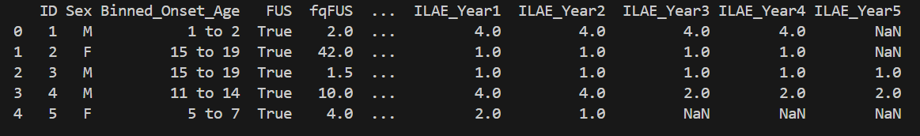
The relevant columns of data
01
OP_Type
Pathology
04
A column that had both the type of surgery and the lobe it took place
What kind of pathology the patient had
*ILAE_YearX
*
ILAE - “International League Against Epilepsy”
An organization that is the main authority for epilepsy research, they decided the numbering system (1-5) for determining the severity of an epilepsy seizure
02
The outcome of severity of seizures at each year after the surgery took place
03
binned_Onset_Age
Take a look at our data!
The age the patient started having the seizures
**take note - not all the relevant columns are presented

Slide 5
02
Data cleaning
(after separating the “lobe” from “Op_Type” column)

Slide 6
We needed our data to have a separate column for the “lobe” so we extracted those from a different column named “Op_Type”, we created a new column called “lobe” and added it to the data. Our data had patients with surgeries in more than one lobe so we went ahead and deleted them from our data. We had a column of data for each year after the surgery, some of the patients had a lot of data missing so we eliminated the patients that had over a year of data missing. What we decided to do for the patients that had just one year of missing data is to take the patient's result from the previous year and copy it instead. The ILEA categorizes the seizure from 1-5, 1 & 2 being “good” scores - meaning no seizures that year and 3-5 being “bad” scores - meaning occurring seizures with growing severity - we decided to filter the data to “good” and “bad” by that. We were also interested in the age of the first seizure and whether it had anything to do with the outcome of the surgery so we took the column containing that data and had to make sure we could work with it, finding out the ages were given as so “15 to 19” (with some exceptions like “under 1” or “over 40”) we took care of that by taking the mean age of that group, and for the exceptions making sure it says 1 or 40 making sure to store the new data in a new column “mean_age” and adding it to the dataframe
The cleaning process

Slide 7
03
Testing functions & Ensuring data

Slide 8
Tests
We made tests for each function making sure it works as expected and catches things that might be problematic with the workings of the function in the analysis further on

Slide 9
01
02
03
ensuring the cleaned data is as expected
All the cells in the “lobe” column were letters, to be precise, “T, O, P, F” after the cleaning
All the cells in the “ILAE_yearX” columns are numeric and 1 through 5 after the initial cleaning of NaN’s
Making sure all of the columns of - mean_age, lobe and pathology have no NaN’s and are numeric

Slide 10
04
Analysis & Visualization

Slide 11
Our analysis
Now that we had cleaned data we could start the analysis: we wanted to find out if there is any significance for the different parameters we tested between the “good” and “bad” data. We decided to run a binomial test, a test that checks for significance between a “winning situation” - the good outcome to a “losing situation” - the bad outcome. For the analysis we used the filtered dataframe, after cleaning and the “good” and “bad” lists. We ran the test between the list of “good” and “bad” data to three different columns - “lobe”, “pathology” and “mean_age”. We have the general analysis function that prints out a list to each specific group in a parameter that has a significant difference between its good and bad lists and gives us the P-value
for example: the group “T” in the parameter “lobe” had a P-value of 0.0000000108

Slide 12
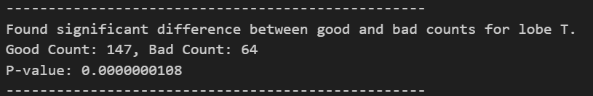
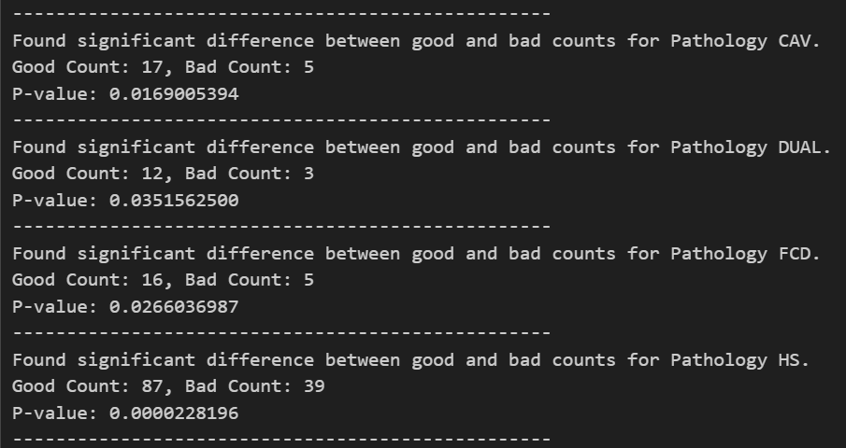
The statistic Binomial test
1. Here we can see the results of the binomial test, proving the only significance is in the temporal lobe:
2. Here we can see all the pathologies that had significantly better results after surgery:

Slide 13
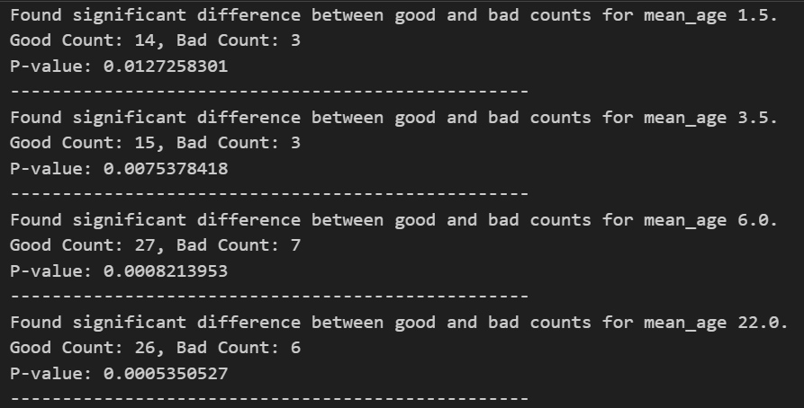
More binomic test results
3. Here we can see all the age categories that had significantly better results after surgery:

Slide 14

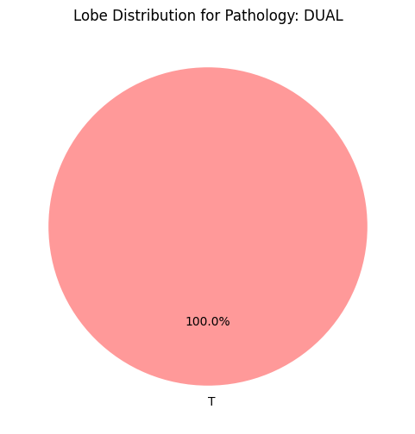
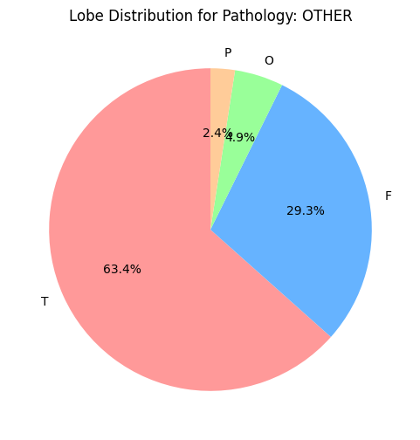
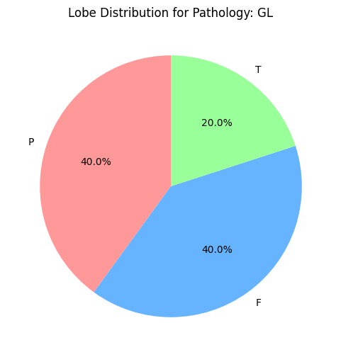
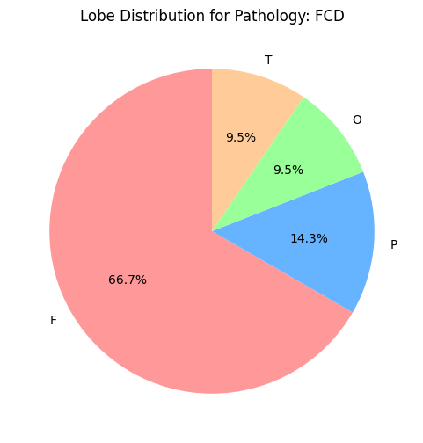
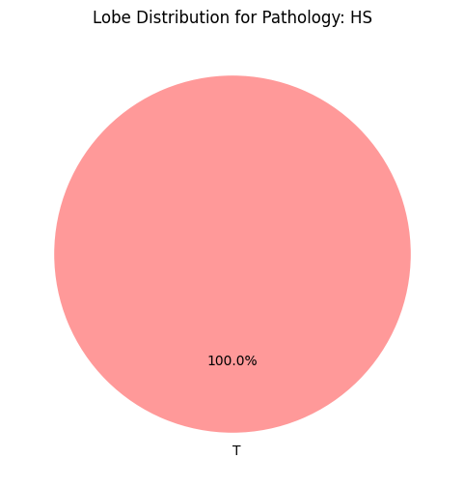
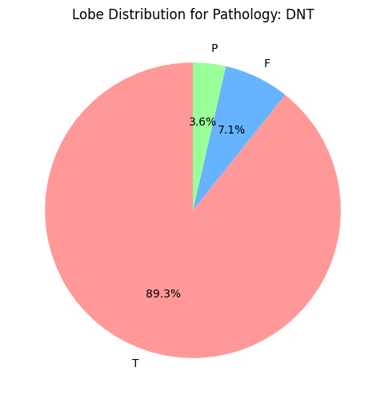
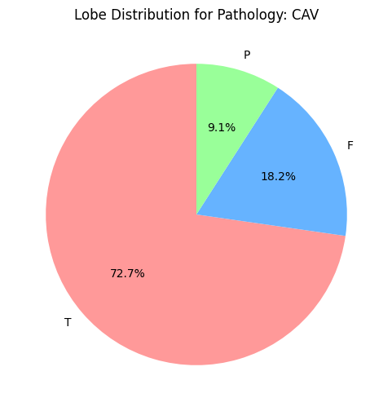
Visualisation
The percent of each lobe in the pathology

Slide 15
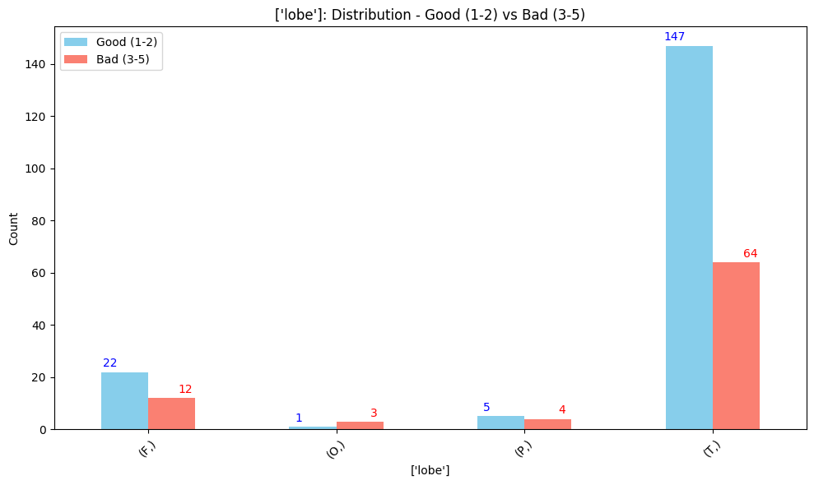
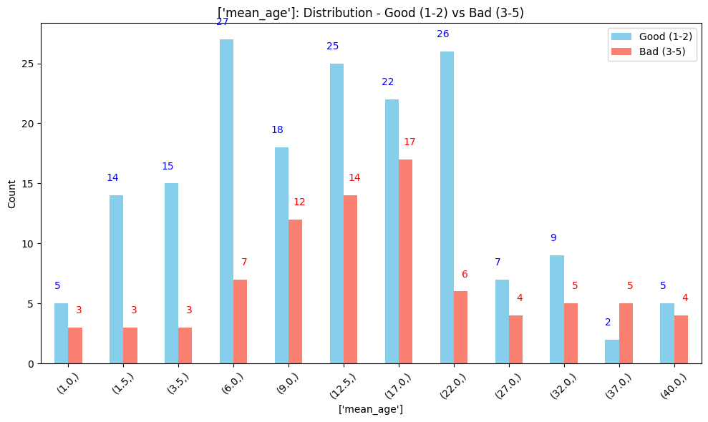
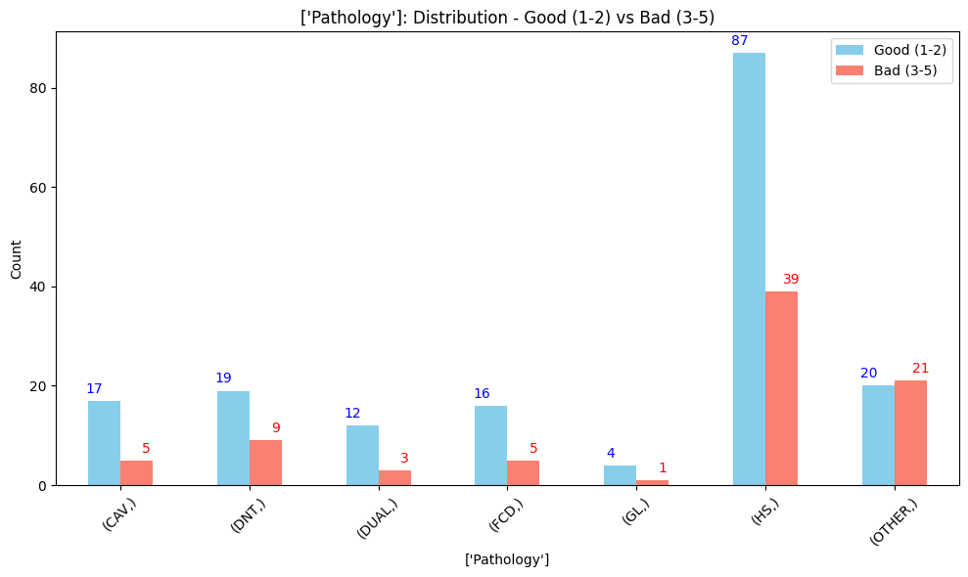
Visualisation
The comparison between the “good” and “bad” lists in each category

Slide 16
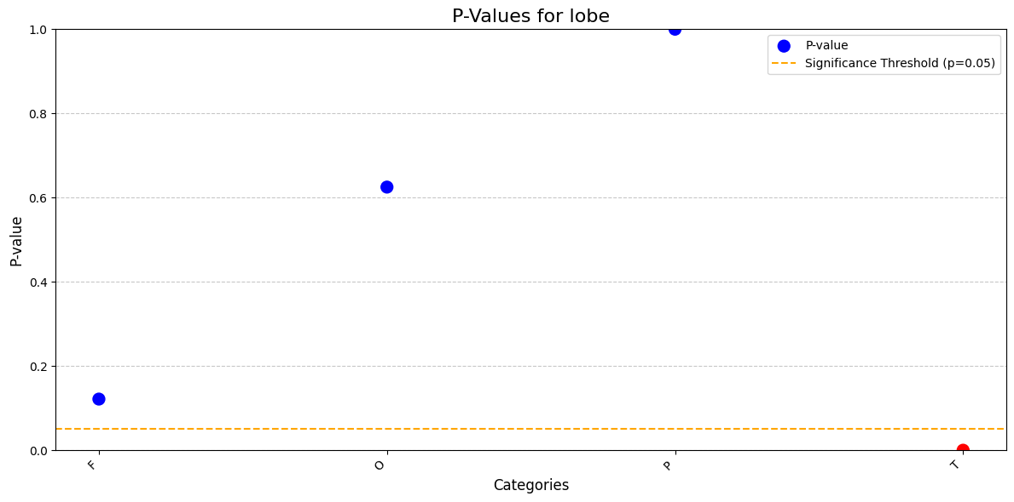
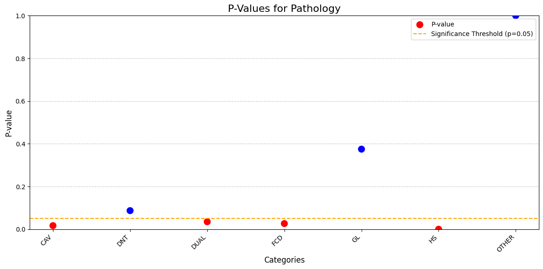
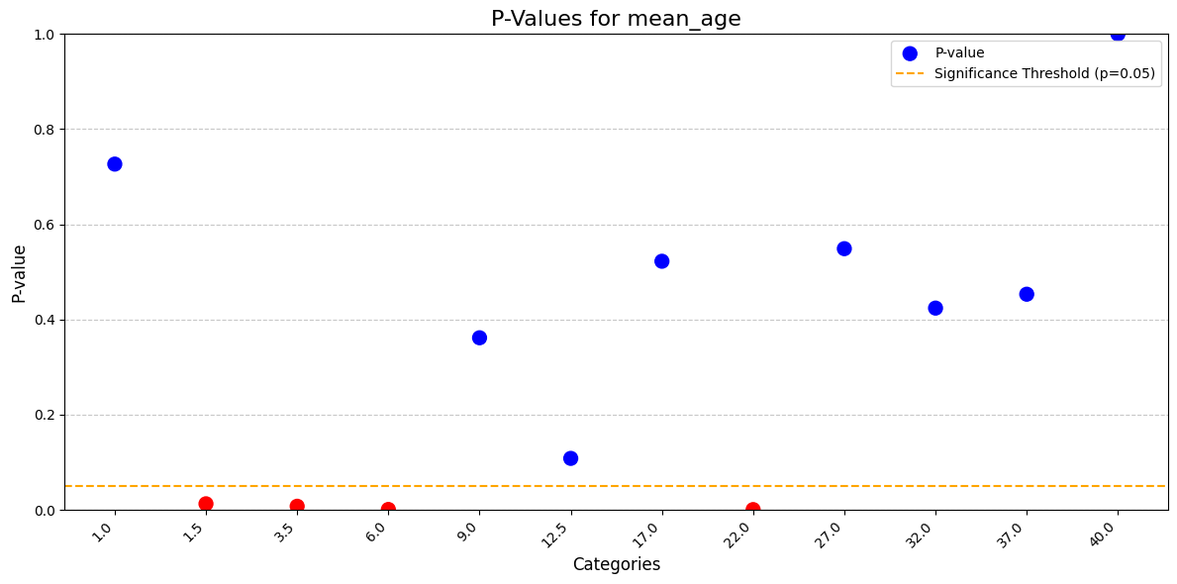
Visualisation
The presentation of the p-values for each category

Slide 17
THANK YOU
FOR LISTENING!
Neta & Shimon

